Slide 1

Stock Analysis
Brandon Mord, Nick Christian, Jacob Iiams

Slide 2
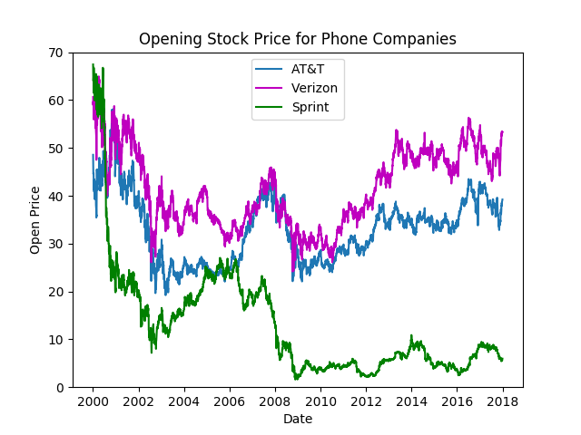
Stock Data
Three Major Phone Carrier's opening prices

Slide 3
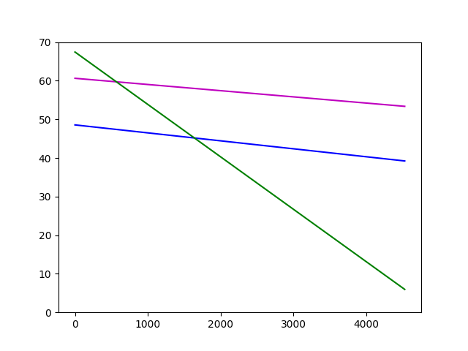
General trend
Price since opening has decreased
Not accounting for stock splits

Slide 4
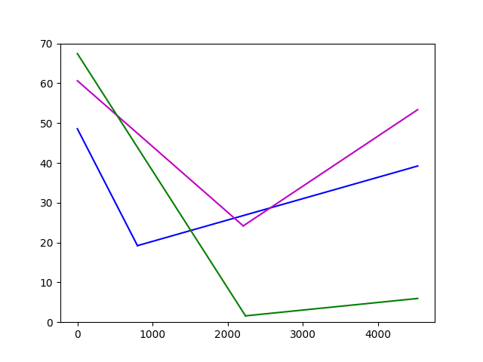
Trend before/After Low point
Each stock has increased since their lowest point
Two lowest points during recession of 2008
One lowest point sometime in 2003

Slide 5
Conclusions drawn
Stock prices of phone carriers trends downward after the turn of the century
After reaching their lowest point the stock prices have recovered slightly
Not recovered to the same level of the early 2000s
AT&T and Verizon have had similar sloping price declines overall from 2000 to 2018 while Sprint suffered during the recession and hasn’t recovered to a similar price. This could indicate the company’s general lacking of value in the public eyes.

Slide 6
Summery
Using stock data of competitors over a period of time can show the difference in value in the public’s eyes.
This allows for investigation into the differences and help to find solutions

